Slide 1


FIFA Mid Bootcamp Project

Slide 2

Introduction
The FIFA game is a popular soccer simulation game that allows players to build and manage their own teams. In this project, I aim to predict player performance and rankings in the FIFA game using machine learning algorithms. Also, I will try to determine which players they should recruit in order to win the next tournament. For this, I decided on ranking players by their market value.

Slide 3

Data Collection and Pre-processing
I’ve collected data on over 17,000 players from the FIFA game, including their attributes such as pace, shooting, passing, and dribbling. I pre-processed the data by cleaning and normalizing it and, also performed feature selection to identify the most important attributes for predicting player performance.

Slide 4

Model Training and Evaluation
I trained several machine learning models on the pre-processed data, including linear regression. I evaluated the performance of each model using metrics such as mean-squared error and R-squared.

Slide 5

Data Gathering
Data Pre-Processing
Cleaning Data
Further Cleaning
Creating Subsets
Merging Subsets
Exploratory Data Analysis
Machine Learning Model

Slide 6

Cleaning Data
I created 3 subsets from the full dataset to analyze a group of variables, and decided to keep Player ID, Age, Nationality, Height, Foot, Day Joined the current club, Day of Contract End, and Market Value of the Player in the second subset. I observed the Hits column was an object that needed cleaning. No duplicates were found, but there were missing values.

Slide 7

Creating Subsets
This text outlines a process for creating a subset of player stats and growth columns. The dtypes of the variables are checked and certain variables are observed, such as growth and base stats, to try and find out what they signify. New subsets are created for further exploration. It is then seen that 5 out of the 7 main categories are equal to the sum of their subcategories, except for mentality and goalkeeping. The subcategories are then dropped and the main categories are kept, assuming they are the same. Finally, it is checked if the sum of the main category values is equal to the total_statscolumn, which it is.

Slide 8
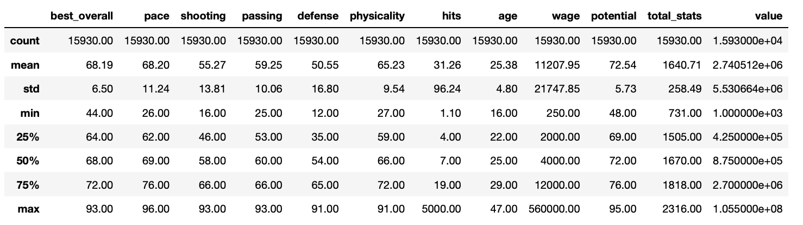
In this table we can see that the
youngest player is 16 ; oldest 47;
lowest best_overvall recorded is 44; highest 93
lowest total stats 731 ; highest 2316

Slide 9
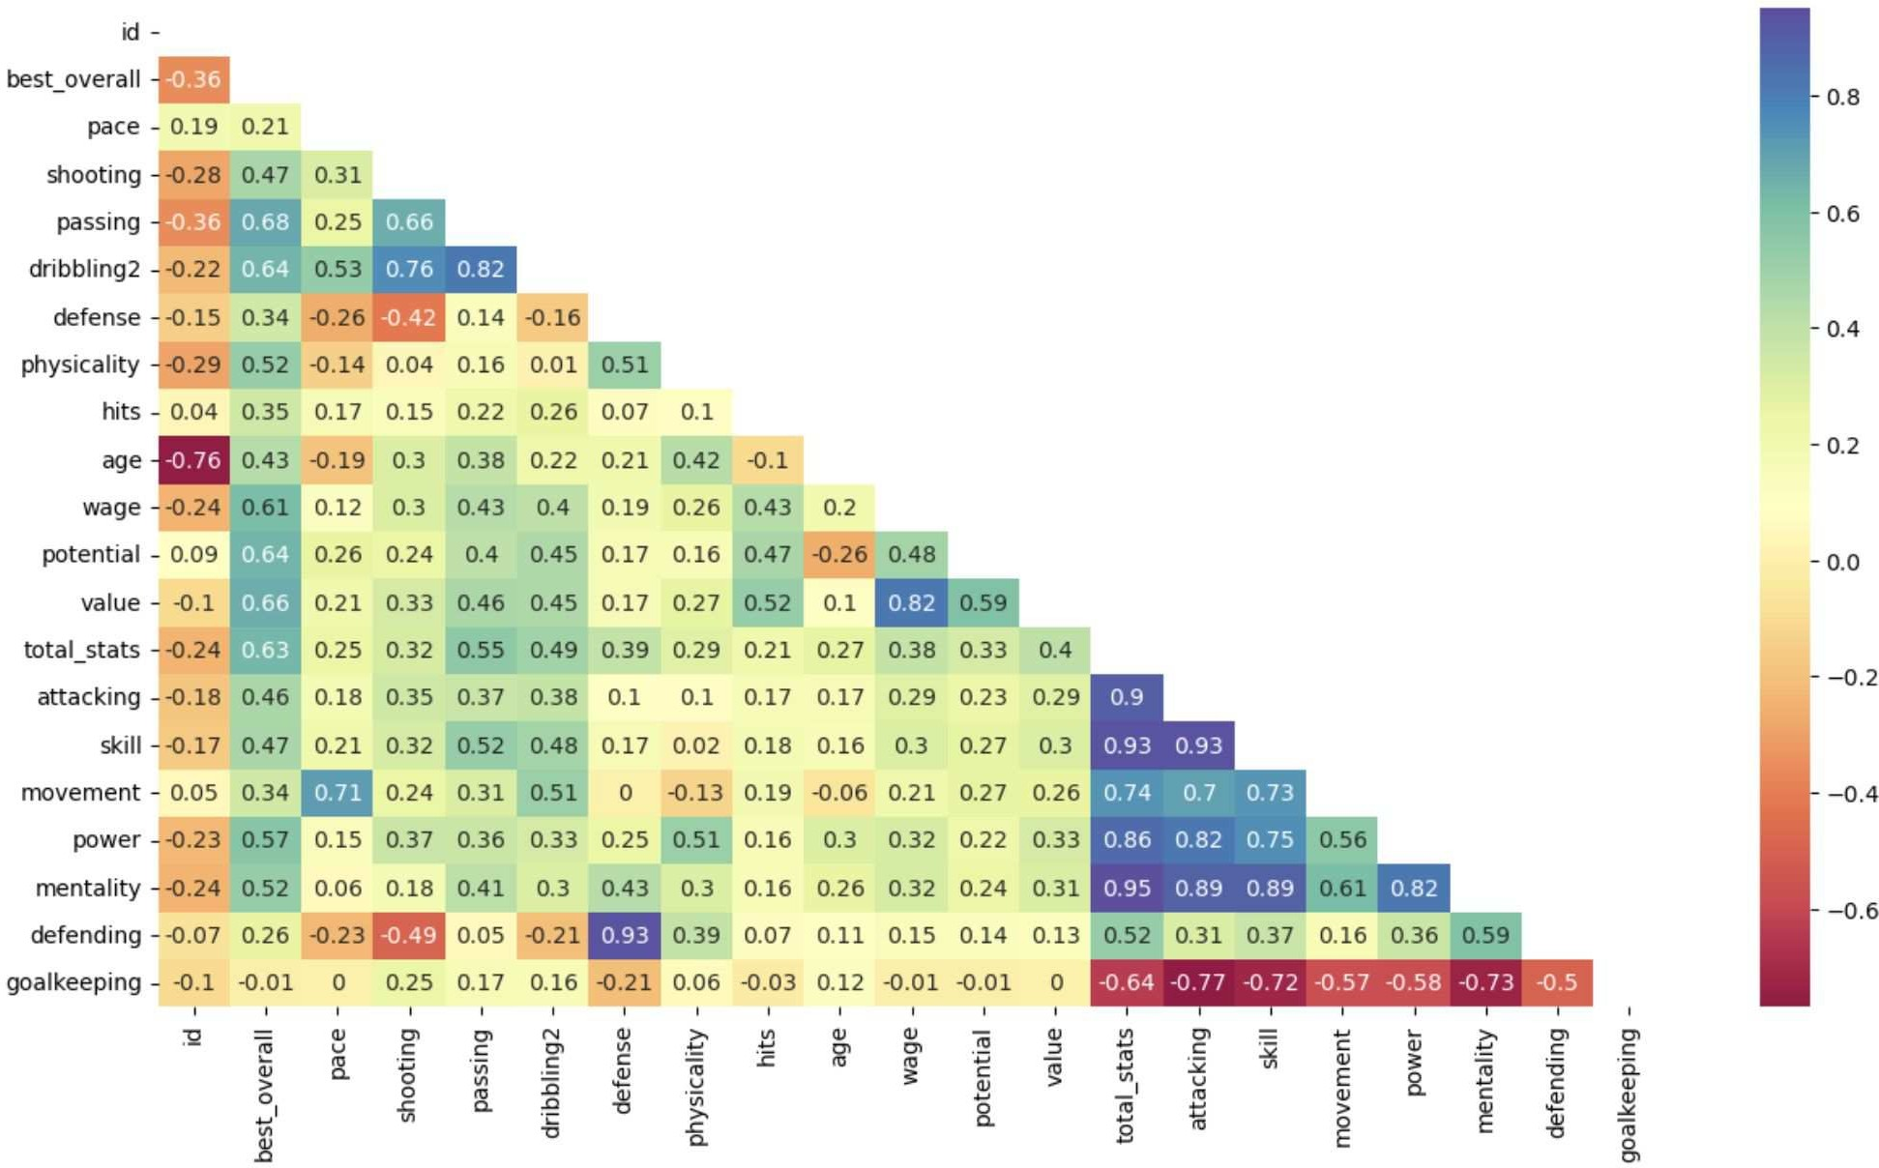
NUMERICAL VARIABLES
Since I got the information that the sum of main categories is equal to the total_stats column, it is not surprising that the variables are highly correlated. What's surprising is how goalkeeping has a negative moderate correlation with total_stats.
dribbling2 is highly correlated with the passing shooting columns. It also does not correlate with physicality.

Slide 10
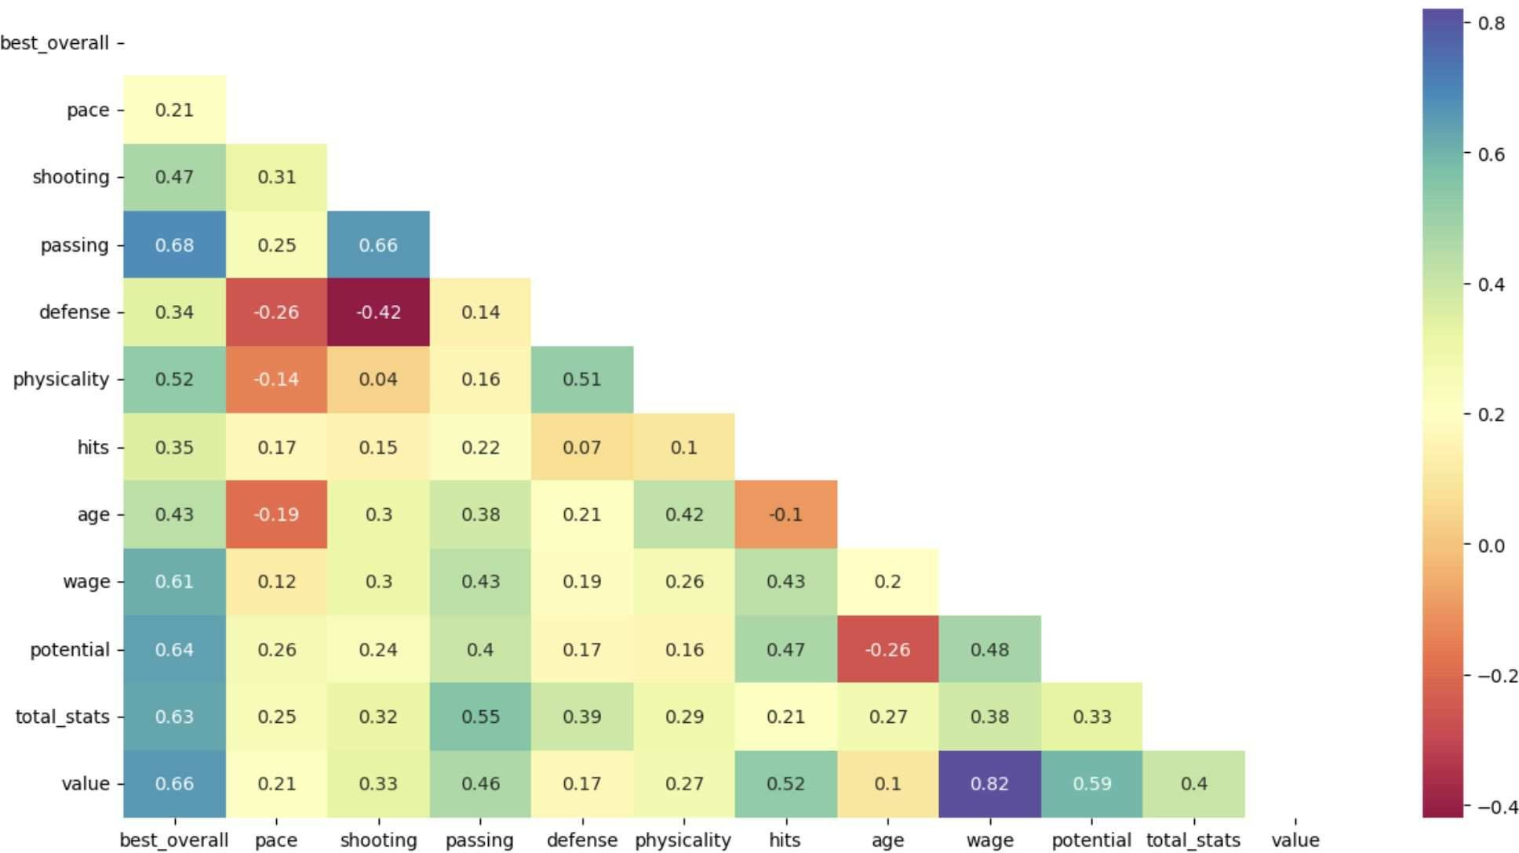
Most Important Factors for Determining a Player’s Value
In this heat map we can see that best_overvall is highly correlated with the passing shooting columns.
The defense has the lowest correlation with shooting.

Slide 11
evaluation metrics
There are 4 types of EM:
It includes the R2 score, RMSE (root mean squared error), MSE (mean squared error), and MAE (mean absolute error). These metrics are commonly used to assess the performance of regression models.

Slide 12
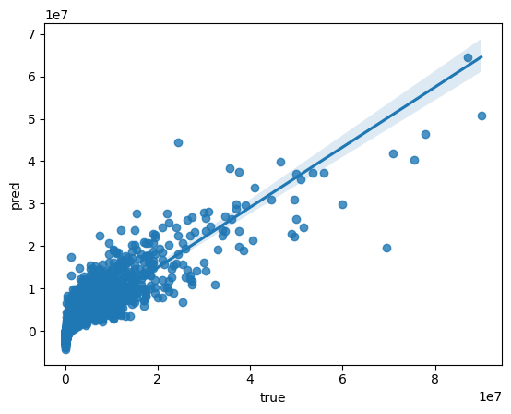
R2 = 0.7619055719752355
Great fit!
RMSE = 2791440.83781945
Predicted values grouped & close to central
curve
→ very slight or no surprises to expect
MSE = 7792141951046.153
Average squared difference between the predicted and actual values across all data points: not bad
MAE = 1439461.4130444052
Average error between original and predicted
value: not bad :
Linear Regression
an appropriate means to perform predictions

Slide 13
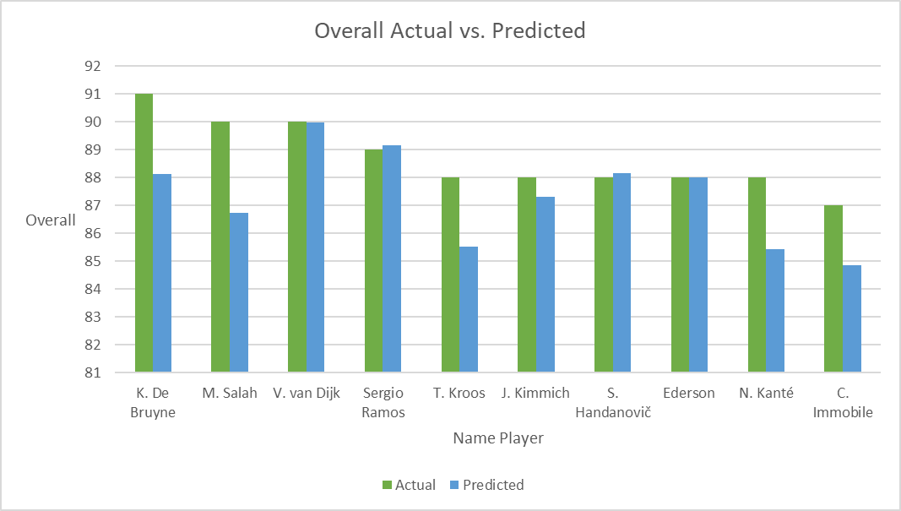
Top 10 Actual vs Predicted!

Slide 14
Top 10 Actual vs Predicted revealed
Name | Actual | Predicted | Difference
K. De Bruyne | 91 | 88.12 | 2.88
M. Salah | 90 | 86.72 | 3.28
V. van Dijk | 90 | 89.98 | 0.02
Sergio Ramos | 89 | 89.16 | 0.16
T. Kroos | 88 | 85.52 | 2.48
J. Kimmich | 88 | 87.31 | 0.69
S. Handanovič | 88 | 88.15 | 0.15
Ederson | 88 | 88.02 | 0.02
N. Kanté | 88 | 85.44 | 2.56
C. Immobile | 87 | 84.85 | 2.15
Name | Predicted | Difference
V. van Dijk | 89.98 | 0.02
Sergio Ramos | 89.16 | 0.16
S. Handanovič | 88.15 | 0.15
K. De Bruyne | 88.12 | 2.88
Ederson | 88.02 | 0.02
J. Kimmich | 87.31 | 0.69
M. Salah | 86.72 | 3.28
A. Robertson | 86.51 | 0.49
David Silva | 85.72 | 0.28
T. Kroos | 85.52 | 2.48

Slide 15




